Slide 1

University of North Dakota
Men’s Lacrosse
President: Reed Miller
Treasurer: Drue Backhaus
Advisor: Mike Moore

Slide 2
About
Student Organized Club established in 1980
Compete in the Great Lakes Lacrosse League's (GLLL) Western Division
Open to anyone but suggest prior experience
Many players from East to West Coast but mostly from MN
School is our priority

Slide 3
GLLL
Tournament Style games on weekends
40+ Teams in the league:
Michigan, Notre Dame, Marquette, Wisconsin, Holy Cross, La Crosse, Winona, Mankato, Concordia, Moorhead, etc.
We hope to have 40 players this year

Slide 4
Commitment
Fall Semester
Fall Ball Tournament: Weekend of October 19th in Fargo, ND against NDSU, Moorhead, Concordia, NDSU Alumni, Canadians
Practice: Wednesday at 5 and Sundays at 3 at the club fields
Intramural box tournament in November
SPRING Semester
Spring Season: Traditionally runs from after spring break to the week before finals
Intramural box tournament in November
Practice: Sunday at 12 at the Wellness
    Tuesday, Wednesday, Thursday during season when weather allows

Slide 5
Equipment
Cascade Pro 7 helmet
Rest preferred within UND colors

Slide 6
Traveling
Tournaments in recent years all over the Midwest: Twin Cities, Wisconsin Dells, Madison, etc. Most are in Western WI / Twin Cities
Travel about 4 weekends so around 12 games per year
Previous years were excused from school for our league championships
Coach busses, vans, and carpooling

Slide 7
Finances
Dues: $425 by October 19th, $500 January 26th, or $550 by March 1st
Cover hotels, league fees, some traveling expenses, helmet stickers, bag tags, goals, balls, miscellaneous equipment.
Sources of money: dues, Nike apparel fundraiser, student government
SOFA funding for transportation and equipment

Slide 8
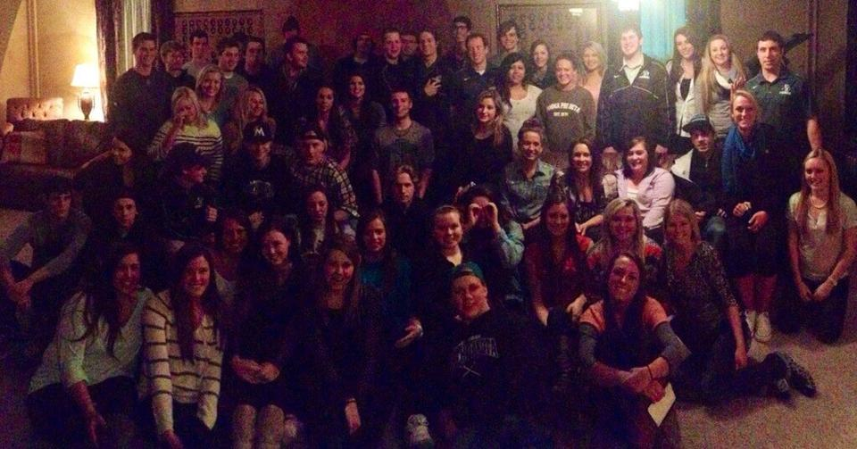
Team Events

Slide 9
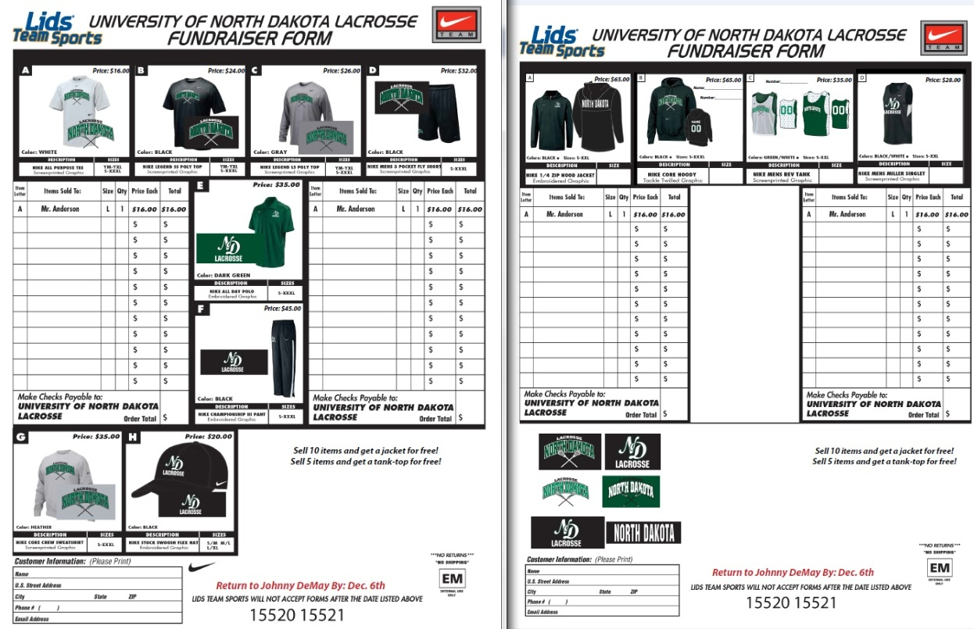

Slide 10
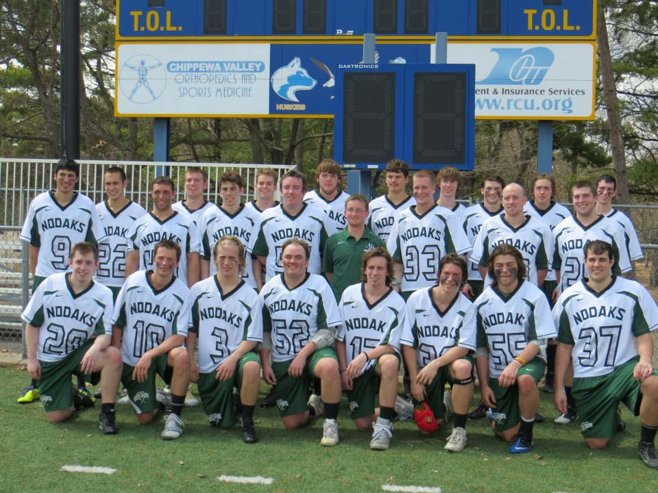
THANK YOU

